Slide 1
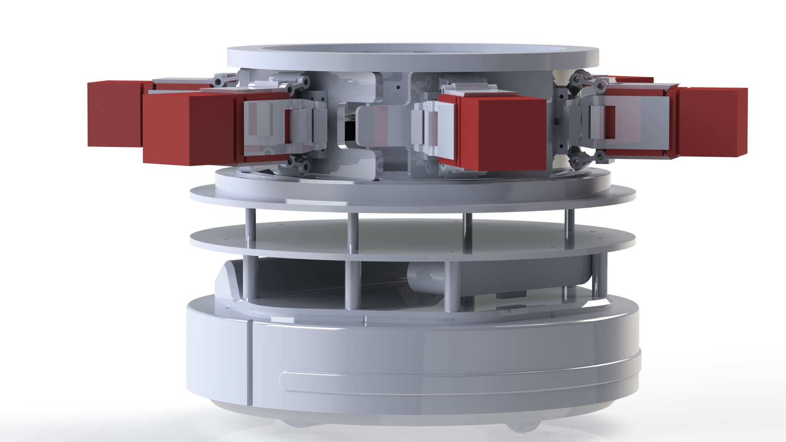
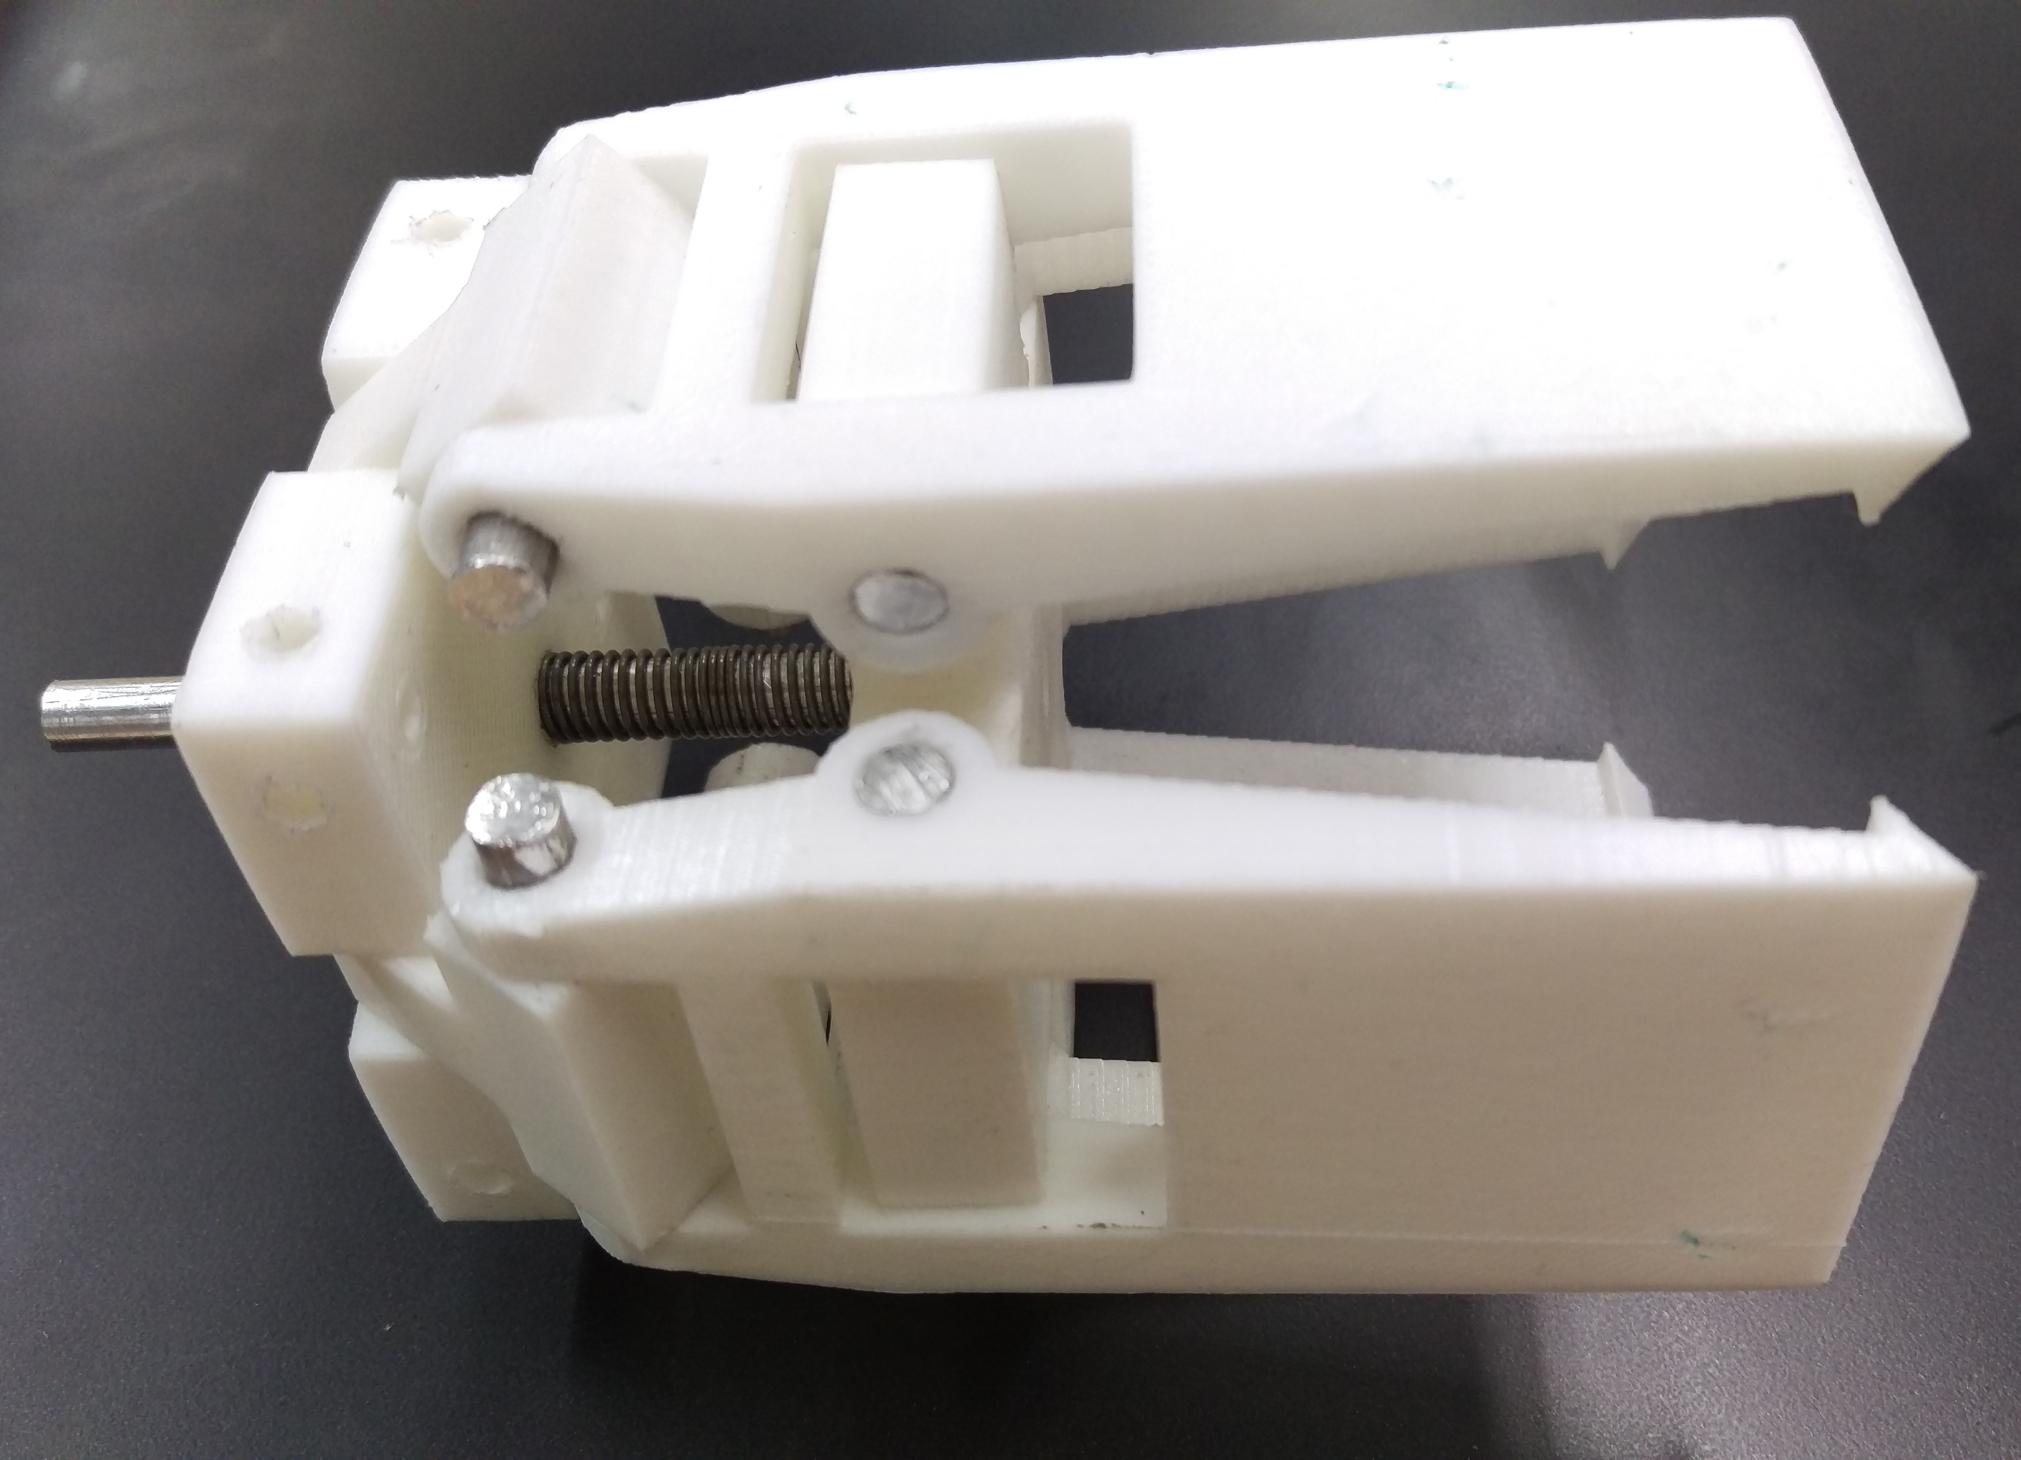
Decentralized control
Minor robot logistics 2
Remco Aarts, Jeroen van den Akker, Robert Delmaar, Bas Janssen,
Addie Perenboom, Dimitri Waard
Introduction
This is a 14 week project form the minor Adaptive Robotics.
The goal project decentralized multi-robot logistics is to create the industry 4.0 by using Turtlebots to transport products.
In this project the Turtlebots are decentralized. That means that the robots decide who will pick up the products.
Figure 1 – The mechanical design.
Hardware
Decision tree
Morphological chart
Multiple specializations
Gripper
Carriage
Figure 2 – The gripper
Software
Simulations
Scales to more robots
Desision calculation
References
Blasdel, A., Leeper, A., & Hendrix, A. (z.j.). Robot operating system. Geraadpleegd van http://ros.org/
Debiec, J. (z.j.). Running ROS across multiple machines. Geraadpleegd van http://wiki.ros.org/ROS/Tutorials/MultipleMachines
Tiderko, A. (z.j.). multimaster fkie. Geraadpleegd van https://github.com/ fkie/multimaster fkie
Hsu, J., Koenig, N., & Coleman, D. (n.d.). gazebo ros pkgs. Retrieved from http://wiki.ros.org/gazebo ros pkgs
Jagielka, J. (z.j.). Multiple robots simulation and navigation. Geraadpleegd van http://answers.ros.org/question/41433/ multiple-robots-simulation-and-navigation/
Gerkey, B. (z.j.). Slam gmapping. Geraadpleegd van https://github.com/ ros-perception/slam gmapping
Natterer, M., & Neumann, S. (z.j.). GNU IMAGE MANIPULATION PROGRAM. Geraadpleegd van https://www.gimp.org/
Correspondence to: Robert Delmaar r.delmaar.student@student.fontys.nl

